Slide 1

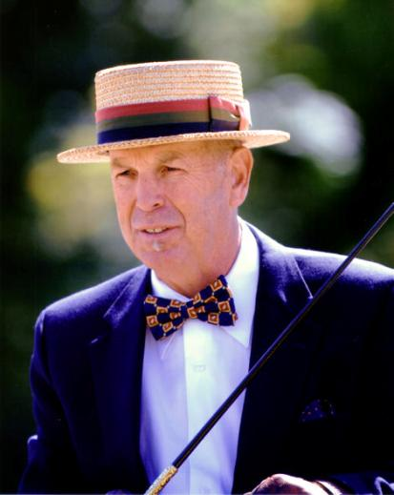
American Driving Society
Harness, Bits & More
Webinar Presenter:
Jeff Morse
ADS Pleasure Committee Chairman
Green Meads Farm
Richmond, MA
www.green.meads.com
EMAIL: greenmeads@gmail.com
Notes:
Welcome to the American Driving Society Webinar.
My name is Jeff Morse, I am current chairman of the ADS Pleasure Driving Committee and I have trained horses in Massachusetts at my own farm since the 70’s. I have specialized in training people and horses for carriage driving for the last 15 years or so. My family brought me up in the world of Morgan Horses and they happen to be very good for carriage driving but I train all breeds of horses and ponies for carriage sports and recreation.
The topic of harness and bits is huge. In the brief hour we have I can only cover it a broad sort of way. I encourage you to ask questions during the webinar as Suzie described. We will not have enough time to answer them all but if you check on the webinar links on the ADS web site, in a few days I intend to have support document there in which I will try to answer all your questions.
In addition, I invite you to ask me any questions privately afterwards thru this email address at the bottom of your screen. So let’s get started…..

Slide 2
Table of Contents
Harness
Bits
Materials
Styles
Sizing
Fitting
Bridles
Saddles
Breeching
Fine Tuning
Collars
Styles
Snaffles
Leverage Bits
Mouthpieces
Cheek pieces
Materials
Fitting
Notes:
Here is our agenda for the webinar. My comments will be primarily focused on the single horse but much of what we will cover will be applicable to the multiples. Also I should say my comments are based on my own experience. Your mileage may vary.
Part I - I will first cover harnesses.
Part II - we will cover the bits.

Slide 3
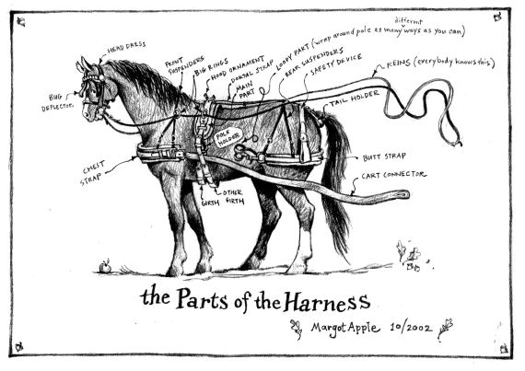
Notes:
This diagram was a Christmas present from a customer of mine who was an illustrator of children’s books. She had an impossible time remembering what each harness part was called, so she drew this to let me know what she meant when she referred to things like: the ‘cart connector’ or the ‘loopy part”
When first presented with a harness it looks like a lot of spaghetti but once you understand what the function of each piece is for, it will make much more sense. Basically the harness can be divided into 4 main pieces:
The bridle, the collar, the saddle and the breeching.
I am going to cover each of these four parts at some point in this webinar but lets first take a look at the different materials for harnesses.

Slide 4
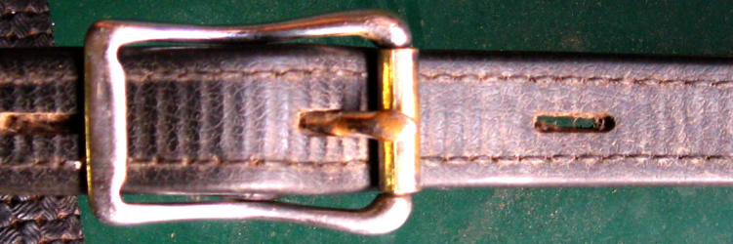
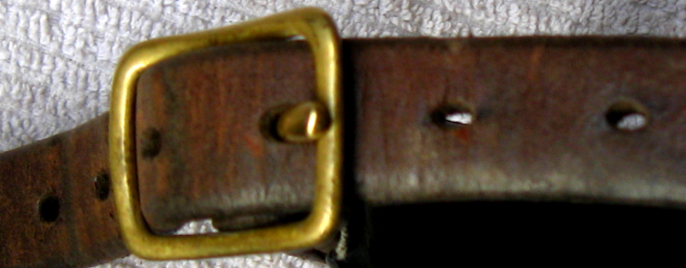
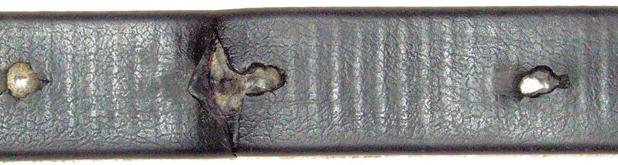
Materials: Synthetic vs.. Leather
Synthetic Oval holes
Leather
Round worn holes
Synthetic
Round worn holes
Notes:
One of the first choices you are faced with when buying a new harness is the choice of synthetic or leather. Leather is of course the time honored traditional material that has served carriage driving well for many, many years but synthetic materials such as beta, biothane and nylon have found to be quite useful for certain jobs.
Leather
Pros: long lasting if cared for, can look beautiful when aged if well maintained, tends to fit and mold in shape better than synthetics.
Downside: Takes more care; heavy; more susceptible to moisture damage. Maybe more expensive
Synthetic – beta is probably the most leather-like and certainly has its place.
Pros: Easy to maintain; impervious to moisture; relatively predictable breaking strength; Lighter than leather
Downside: Non-traditional and may look out of place where presentation and turnout scores matter. Synthetic materials are stiffer when cold and do not develop attractive aged patina; I think the jury is still out when it comes to the length of time it can be in useful service.
Nylon – hair and dirt readily stick, causing chafing (must be kept extremely clean); cheap, slick nylon contains stiffening agents that cause rubbing and chafing. Edges of woven nylon tend to be sharper and can wear on hair and skin.
One problem I have noticed with synthetics is that builders are still using some techniques that evolved with leather craft which may not work as well with a material that does not stretch compress quite the same way as leather. For instance, buckle tongue holes.
Combos – Leather and synthetics can work well together but construction techniques are still a work in progress.

Slide 5
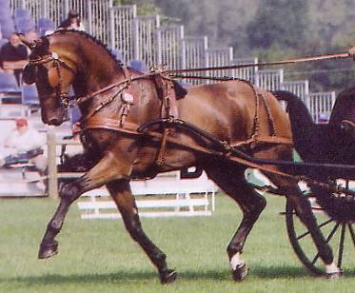
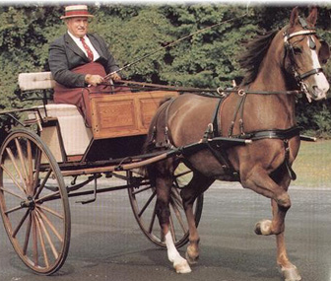
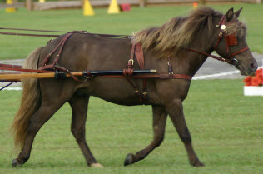
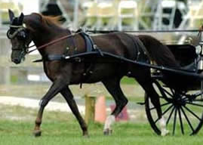
Colors: Black vs. Russet
Notes:
Another choice you may have to make is whether to use black or russet leather….and yes, synthetics now come in brown….and in fact in many other colors too. As I was researching this webinar, I evne came across a harness for a mini with colored crystal sparkle inserts, instead of patent leather.
2002 World Singles Stephane Chouzenoux
Black vs. Russet
Some horses look better in either color than others will.
Black harness is considered appropriate with painted vehicles, with shaft and pole trimmings done in black. It is also considered appropriate with a natural wood vehicle with iron parts painted any color except brown. Shaft and pole trimmings, dash and fenders are done in black.
Russet harness is considered appropriate with:
a) Natural wood vehicle with brown or black iron
b) Painted vehicle with natural wood panels with any color iron or
c) Vehicle that is painted brown with brown iron. Shaft and pole trimmings
should match the harness.

Slide 6
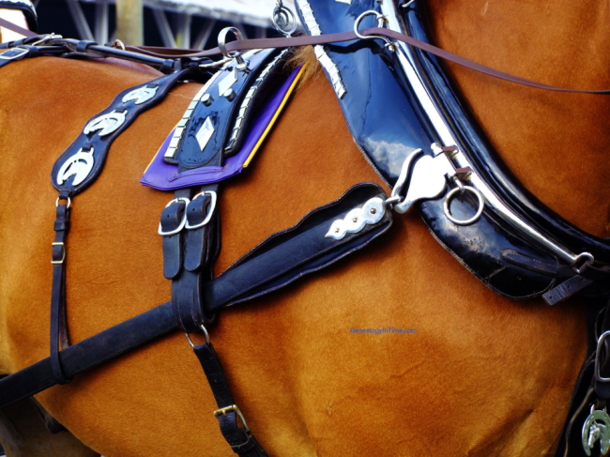
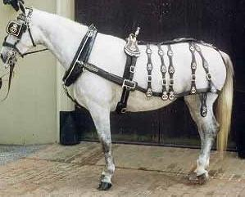
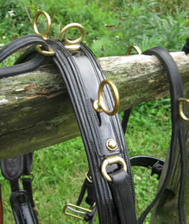
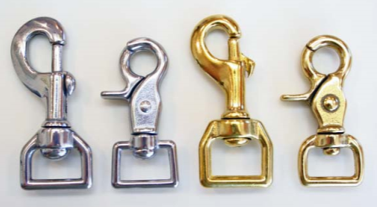
Hardware: Brass vs.. Chrome/Stainless
Notes:
You will also be faced with a choice of metal for the buckles and other metal fitting on your harness. Generally the choice is between brass or chrome. But sometimes stainless or even gold or silver plated fittings are used.
Brass vs. Chrome
In any event, Vehicle and Harness hardware should match.
Brass takes effort to maintain but looks great when done right, Brass may not always be as strong as other metals.
Chrome plating subject to wear and tear
Stainless – expensive but durable and easy to care for and great where strength is really needed like for Combined Driving trace shackles.
One of the nicest harnesses I have ever seen was a 100 year old, russet harness with silver plated fittings with the fittings lined in ivory.

Slide 7
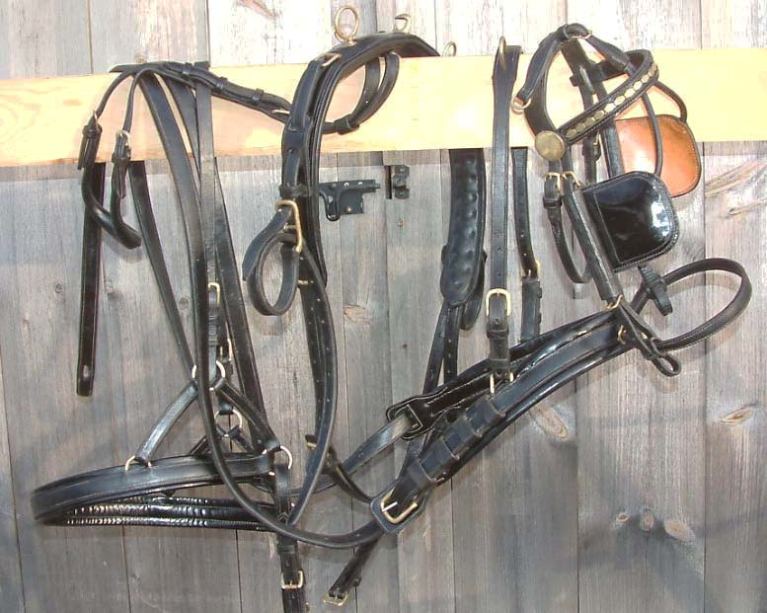
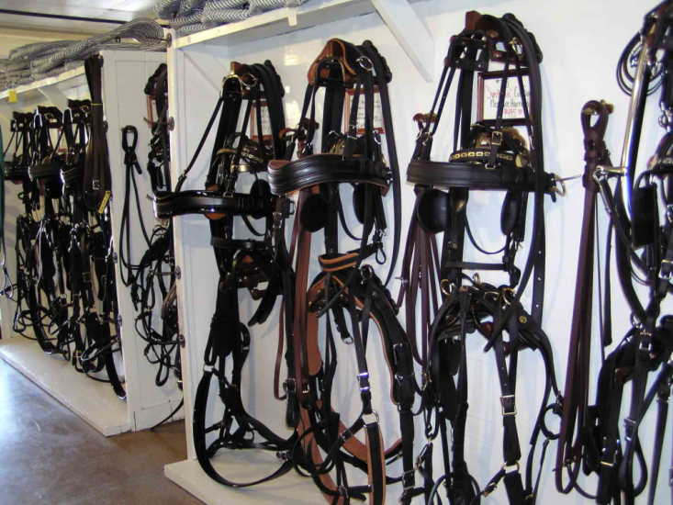
Condition: Used vs. New
Notes:
New vs. Used
The choice of buying new or used harness should be considered carefully.
Good quality Used Harness often holds its value if well cared for so while it may be less than an equivalent NEW harness it may be selling for close what its sold for originally when it was new. Basically you get what you pay for and if it cheap, then buyer beware: it may not be safe. Or you may be very fortunate!
In any event, Used harness needs to be very closely examined.
If you are not experienced, buy from a reputable dealer or seek a knowledgeable person to help you.
One thing you can NOT see in a used harness is the stress the stitching has been subjected to in a wreck. Proceed with caution.
Never buy a harness you can not physically see and touch unless you absolutely trust the seller. You life may depend on it.
Another disadvantage to used harness is that usually you have to take it as it comes with no ability to swap out parts that will not fit your horse.
With a new harness, the seller will likely be very willing to substitute bigger or smaller parts as needed to best fit your horse.

Slide 8
Harness: Types
Style must match the job
Recreation
Pleasure Competition
Combined Driving
Presentation & Marathon
Distance Driving
Training
Draft
Notes:
There are many, many types of harness and styles and variations within the types but basically they can be broken down into the following types, and I will show you examples of all of these:
Recreation
Need not be fancy but must be safe and serviceable
Pleasure Competition
Finer than a CDE harness, perhaps with patent parts. Strong enough for medium duty use.
Combined Driving
Heavier duty harness, wider and thicker strapping and maybe more padding.
Lower Levels, one harness may suffice;
Upper levels need a Marathon and a fancier presentation harness
Distance Driving
Comfort is a must, a good fit imperative.
Training
More flexibility in adjustment, sturdy subject to a lot of abuse
Working
Designed specifically for the job of draft work

Slide 9
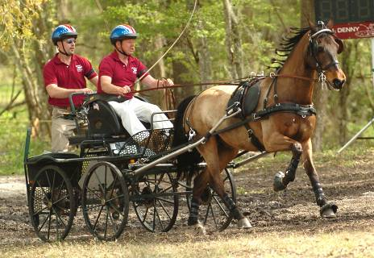
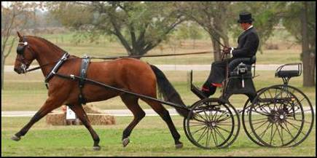
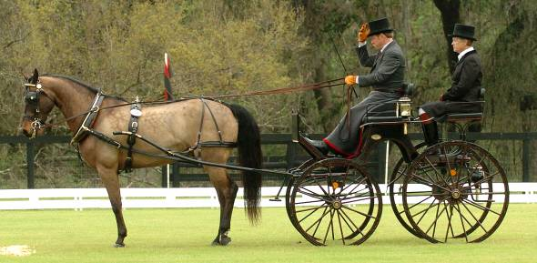
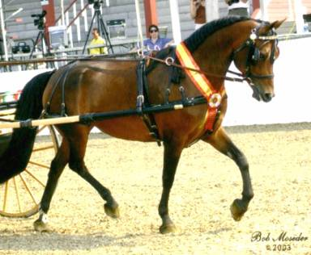
Style: Competition
Notes:
Top left: very simple understated harness….no breeching to interfere with the eye. This might be used where the quality and elegance of the turnout is judged. It would not be used where strength and durability were primary concerns, such as in the Marathon Phase of a Combined Driving Event. Every vehicle must have some mechanism for braking. Since the breeching is not used, which would be serving as a braking mechanism, In this case, the vehicle has a foot operated brake so breeching is not required. Nevertheless, this set up would be more appropriate on more or less level ground. Like a dressage arena.
Bottom Left: almost identical carriage and turn out as the top left but with breeching notice how it adds a bit of clutter to the eye. Still it was good enough to win Presentation and the Individual Bronze Medal at the World Singles Championship, Conty, France, August 2002 for Fred Merriam and his Morgan Gaitwood Lightwing.
Top right: heavy duty marathon harness. Note the wide pad on the back. To help protect the horse from the tip of the shafts. Everything is slightly thicker and more heavy duty and has more padding to withstand the rigors of the job.
Bottom right: a lighter duty pleasure competition harness with some patent leather pieces, brass fittings. Generall finer than a CDE harness.

Slide 10
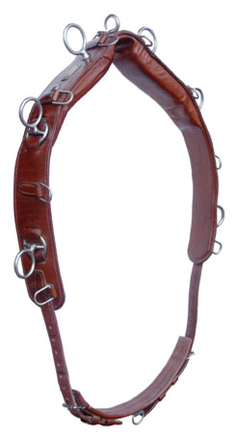
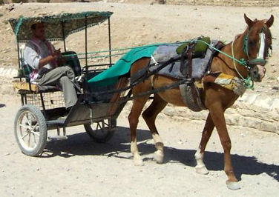
Style: Other
Distance Harness??
Training Surcingle
Notes:
Here we have a saddle from a training harness.
And a distance driving set up with tons of padding and shading to keep his horse as comfortable as possible!

Slide 11
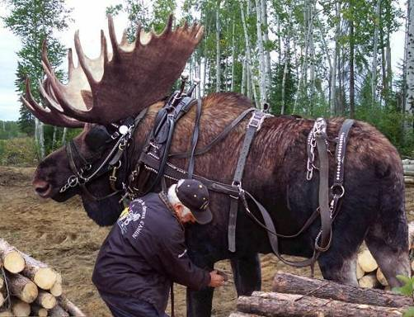
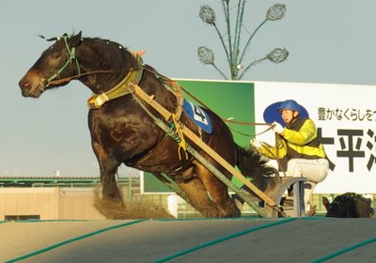
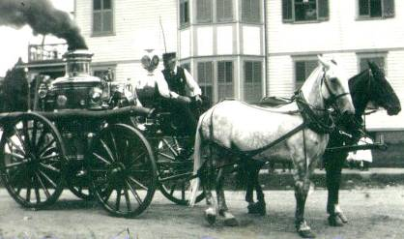
Style: Draft
Work Harnesses
Notes:
Draft or work harnesses need to be very heavy duty like the Heavy work harness on a moose.
Note: the bare essentials on the fire horses….. a collar and some breeching
The bottom right is a racing harness for draft horse that race in Japan pulling very weighted sleds. It’s heavy duty, but reduced to only the bare essentials for the job.

Slide 12
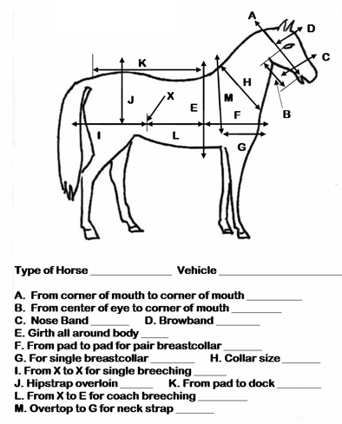
Harness: Sizing
Notes:
When it comes to sizing your harness, most dealers will have you provide measurements to help them choose or make the right size parts. While there are basic sizes commonly used, like Mini Pony Cob Horse Draft those are really just staring points and some parts may have to swapped in and out of the package to best fit your horse or pony.
Ponies are the most problmeatic in this regard because
The smaller the equine the more critical the fit becomes.
Good dealers will mix and match harness parts to get the fit right. Do not be afraid to ask and expect there to be some back and forth.
Each dealer or manufacturer will have a slightly different way they want you to measure your horse.

Slide 13
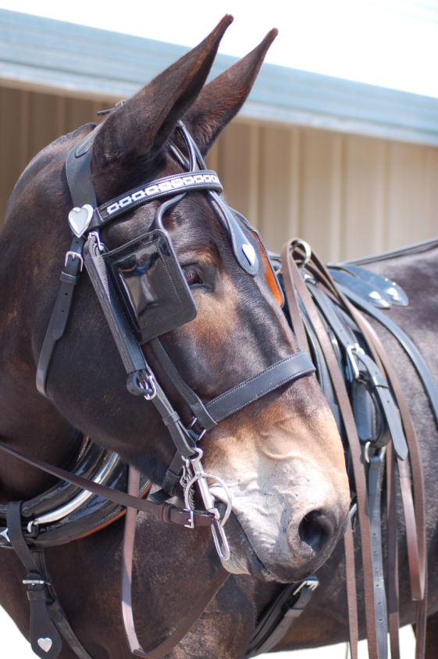
Harness: Bridles
Parts
Brow Band
Crown Piece
Blinders
Cavesson
Throat latch
Bit height
Notes:
So now we come to talking about specific harness parts. Bridles can be purchased in some standard
"sizes" - pony/Arab/cob, horse-sized, Warmblood-sized, draft size etc. - but it's generally much more practical to deal with actual measurements especially with Ponies since there is a smaller tolerance for error in fit. And like other harness parts, expect to go back and forth with the seller to get things just right.
Brow Band
Should be long enough to lie comfortably and not keep the crown piece from sitting far enough behind the ears to be comfortable.
Crown Piece
May be straight or curved should lie well back from the base of the ears.
Blinders
Eye should be in the center; Lie snug to the face; adjust for more or less vision; should never be floppy; trim eyelashes.
Shape will be dictated by personal preference and by style of vehicle and harness.
Blinderless bridles: use them if they work for your horse.
Blinders are NOT required for ADS competitions.
Cavesson or Nose Band
May be separate or integral to the Bridle
Should initially be placed about the width of your thumb below the cheekbone and well above the corners of the mouth so as not to pinch the bit
Should be well padded below the jaw; Should not be super tight. It is NOT used to clamp a mouth shut!
Be careful about adjusting this. Use curb chain guard under the jaw.
Throatlatch
Adjusted to allow breathing when well flexed at the poll.
May also use a Gullet Strap
Bit Height
1-2-3 wrinkles in the corner of the mouth; *WILL* vary from horse to horse. Pull the bit straight down to fully seat and engage the crown piece. Then lift the bit up slightly and look at how much play there is between the bit and the strap from which it hangs. Experience will tell you how much play to have here but it usually is not more than ½ an inch or less. Varies with the size of the horse!!

Slide 14
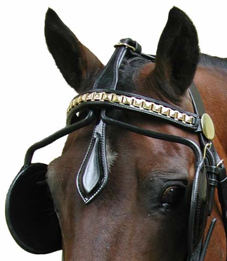

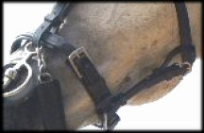
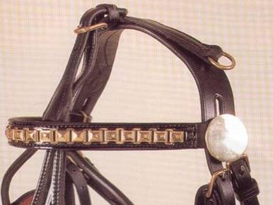
A Custom made Bridle
Gullet Strap
Shaped Crown
Notes:
Top we have a straight crown piece that sits well behind the ear because the brow band is long enough not to pull it forward, tight behind the ear.
Bottom left: brow band length is often too short. This is a curved or shaped crown piece that allows for the crown to be placed well behind the ears. Some conformations will benefit from this kind of crownpiece.
Top right is a completely custom made synthetic bridle with chrome fittings for John Henry the mule. It’s a little hard to get an idea how big this bridle is but his ears are over 12 inches long: shaped crown piece to fit the back of the ears. But is is made well and fits well maybe the browband could be a hair longer to allow the crown piece to sit a tad bit further behind the ears.
Gullet Strap: runs from bottom of nose band to throat latch makes it more difficult for a horse to slip his bridle off.

Slide 15
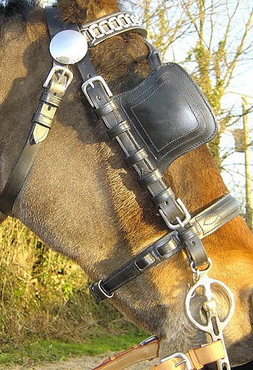
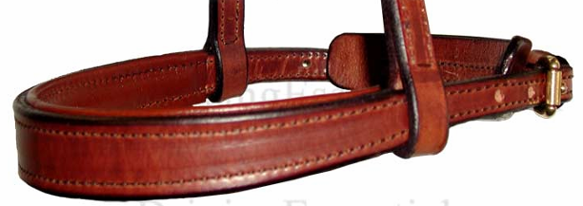
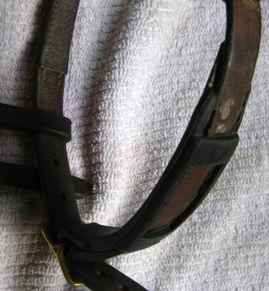
Noseband Fit
With Rubber Curb Guard
Notes:
Top right: a sliding cavesson arrangement whereby the cheek pieces can be exactly placed on the side of the head.

Slide 16
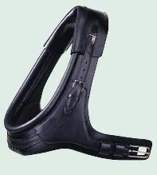
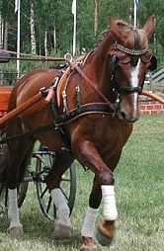
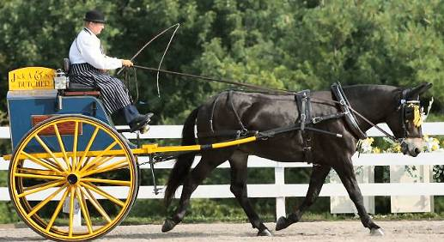
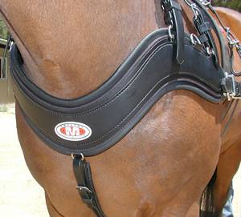
Harness: Collars
Breast Collar
Full Collar
Combo Collars
French Collar or Brollar
Empathy Collar
Full Collar
Notes:
Breast collars
Pros: easy to fit and adjust from horse to horse; Suitable for light vehicles
Downside: may unduly interfere with freedom of shoulder movement
Should fit above the point of the shoulder and below the base of the throat
Full collars
Pros: may allow for better freedom of movement of the shoulder making the horse more efficient
Downside: More complicated to fit and to put on the horse
Combo collars
Specialized equipment suitable for Combined Driving; Expensive.

Slide 17
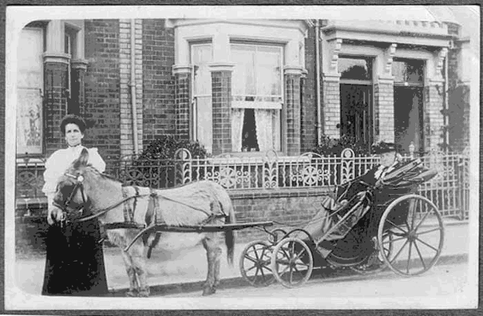
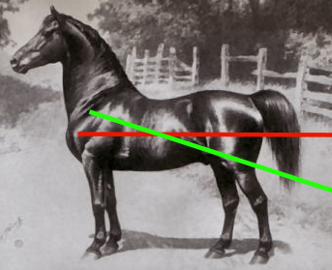
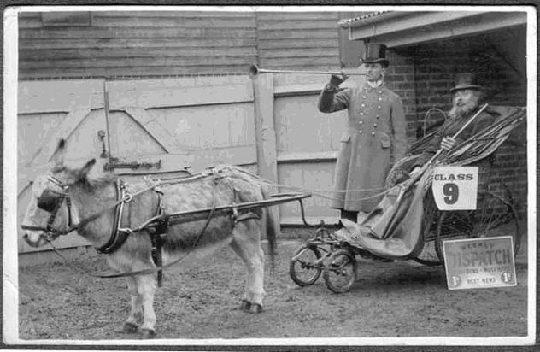
Breast Collar vs. Full Collar
Breast Collar
Full Collar
Notes:
Breast collars should usually only be used where the line of draft is above the axle so that the traces are not pulling down on the shoulder.
Full collars should only be used where you have an angle of draft from or near the level of the axle. This is the most efficient set up for pulling a vehicle.

Slide 18
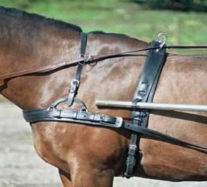
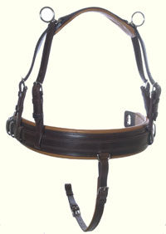
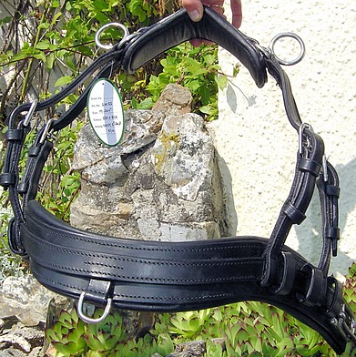
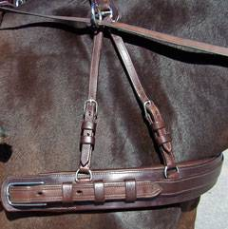
Breast Collars
Drop Front or Shaped Collar
Notes:
Top left: note the placement of the neck terrets so that a nice unbroken line can be maintained with the rein.
Bottom left: drop front breast collar may fit the horse with the low neck high shoulder conformation
Bottom right: see the bottom of the neck is being interfered with by the breast collar

Slide 19
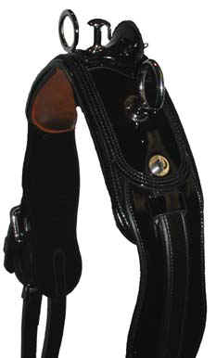
Harness: Saddles
Parts
Treeless vs. Tree
Girth
Tugs
Open or English
French or Tilbury
Placement
Notes:
Saddle
Top front edge of the saddle should be placed about the width of your hand behind the last hairs at the base of the mane
Treeless Saddle
Pros: Close contact allows for wide area of displacement of pressure
Cons: Unless well constructed, may place pressure directly on the spine
Treed Saddle
Pros: Time tested design
Cons: Often trees not shaped to fit the contours of the back
Girth
Should be snug but not nearly as tight as a riding saddle girth
Should be positioned well back from the elbows
May be used with a pad for sensitive horses
Tugs – I’ll show you these in a later slide.

Slide 20
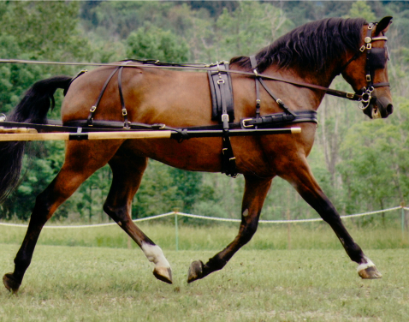
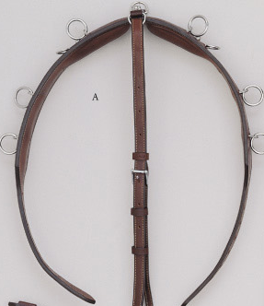
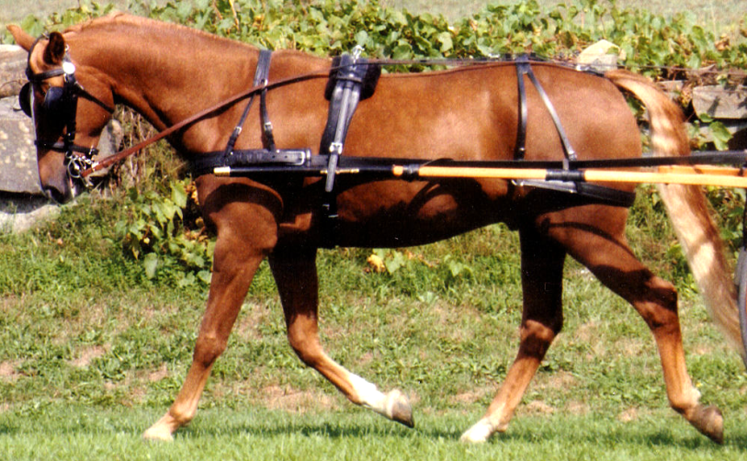
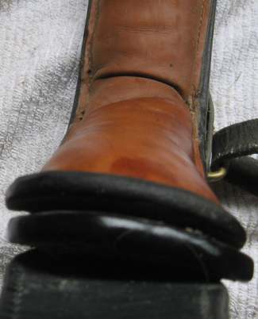
TreelessSaddle
Tree Saddle

Slide 21
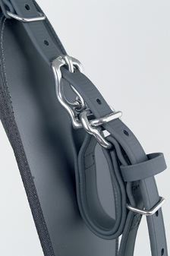
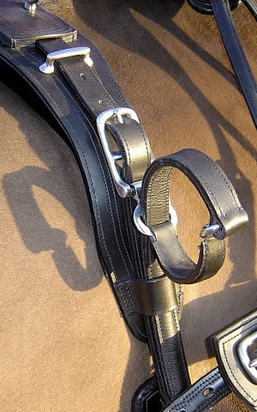




Tugs Styles
Notes:
The Tug is the harness part that keeps the shaft from falling on the ground. With a straight shafted vehicle such as we see here, It generally is adjusted so that the tip of the shaft is at the point of the shoulder and the shaft is sloped downwards slightly from the tip back towards the rear. With curved shaft vehicles that may vary somewhat. The technical aspects of balancing a vehicle are too detailed to get into her but generally speaking, for 2 wheeled vehicles, when there are people seated in the vehicle, there should be hardy any weight in the tug. For 4 wheeled vehicles you would only have the weight of the shaft itself in the tug.
There are several types. The most common is the English or Open Tug. It allows for some shaft movement and it is used with most two wheeled vehicles with straight shafts.
French tugs are suitable for curved shaft vehicles which are difficult to balance on their own and need to be held in place.
Tilbury tugs, very similar to the French tug are used on 4 wheeled, single horse vehicles.
Quick Release

Slide 22



Harness: Backstrap/Breeching
Back strap
Crupper
Breeching
Crupper
Spider backstrap
Notes:
Backstrap provides the architecture from which to hang the breeching and a little bit to keep the saddle in place.
Should not be tight;
The crupper: Should be smooth and well shaped for the area under the tail; Should have buckles for ease of placement; May be wrapped to help with
horses that flip or clamp their tail
Breeching I’ll show you on the next slide
Spider backstrap/breeching does not need a crupper. Useful for tail clampers.

Slide 23




Breeching Too Low
Breeching about right
Notes:
The breeching
Takes more adjustment than other harness parts to get exactly right.
Should be below the point of the buttock but high enough not to interfere with hind leg movement.
Should be able to put a fist between the breeching and the horse when on level ground and in draft.
Hanger strap adjustment and breeching strap length should allow for the breeching ring to be at about the stifle.
Top photo: breeching is about one hole too low. Generally, that is the error most often made. Could be fixed by adjusting the rear hanger strap to get it to hang correctly.
Bottom: breeching about right.

Slide 24




Harness: Kick Strap
The best $25 Insurance you can buy!
Notes:
Kicking Strap
The best insurance you can buy after your helmet.
Can be integrated into existing or new harness to be unobtrusive.
I use one on every horse, every drive at home.
Should be quick to attach or you won’t use it.
Should be sturdy.
Should not be placed too far back on the croup.
Should be loose/ i.e. not engaged when horse is in normal travel mode
Should not allow the horse to get a leg over the shaft.

Slide 25



Harness: Tweaking
Temporary alterations
Permanent changes
Pads
Notes:
Don’t be afraid to alter your equipment to make life easier and more pleasant for your horse. Anything you can do to improve the efficiency of the job is probably worth doing. Don’t be afraid to experiment a little. Harness makers construct equipment based on very general measurements. For instance, they place saddle terrets based on where the holes are in the trees they use not necessarily on where the best position might be for your particular horse’s conformation. Moving a saddle terret or neck terret down 1” may make a huge difference. And I’ll show you an example of what I am talking about in the next slide.
Pads
Ideally, you should not try to make your horse’s equipment fit by using pads. It should fit well without pads. You can improve the performance of some equipment by adding pads. Fluffy pads absorb sweat and water; Gator Pads do not. Pads can increase body heat. A poor fitting pad is worse than no pad.
Pads may not be appropriate when scores for turn out or presentation count.

Slide 26



Harness: Tweaking

Slide 27
Questions?
Bits
Styles
Snaffles
Leverage Bits
Mouthpieces
Cheek pieces
Materials
Fitting
Notes:
Before we move on to bits, maybe here we can have a few questions.

Slide 28
Bits
“ What does it feel like to be this animal of flight, who must submit to being strapped to a carriage and controlled through a piece of metal in his mouth, doing things and going places he would never dream of doing on his own?"
Heike Bean ~ Carriage Driving: A logical Approach Through Dressage Training
Notes:
The bit is the gateway to the equine brain. Without an effective tool to communicate your instructions to your horse, your performance will suffer. Without the skill to effectively speak through your reins to your horse, your performance will also suffer and perhaps your life and your neighbor's lives will be at risk. Horses are not born with a bit in their mouth and they are not born understanding what a bit is for. They must be trained to understand the language of the bit and it can not be done all at once. The refinement of the language of the bit is perhaps infinite. The understanding by your horse of the subtleties of bit instruction (language) can and will take years. While training your horse should be a fun and rewarding process, you must be willing to take the education process seriously to be fair to your horse. He did not ask you to train him. He did not ask for a bit in his mouth. Heike Bean, in her very valuable book, Carriage Driving, put it this way:
“What does it feel like to be this animal of flight, who must submit to being strapped to a carriage and controlled through a piece of metal in his mouth, doing things and going places he would never dream of doing on his own?"
Bits are not magic. They do not come with an automatic education. A $200 bit will not suddenly and magically deliver perfect 10's on a dressage test. Your horse must be capable of appreciating what you put in his mouth and be capable of understanding the communication he receives through it. That takes skill on the part of the driver and is best learned with the help of someone who is experienced at teaching such things. It's very difficult to accurately put into words the feel and timing of rein work. There are several books that explain bit theory and concept but there is no substitute for the live action and a good teacher.

Slide 29
Bits: Styles
Driving Bits vs.. Riding Bits
Non-leverage Bits
Snaffles
Bitless
Leverage Bits
Liverpools
Butterfly
Kimberwicks
Notes:
SNAFFLE - A snaffle bit consists of a bit mouthpiece with a ring on either side. With a snaffle, one ounce of pressure applied by the reins to a snaffle mouthpiece will apply one ounce of pressure on the mouth.
A snaffle is not categorized by whether the mouthpiece does or does not have joints in it.
A bit is a snaffle because it creates direct pressure leverage on the mouth.
A single- or double-jointed mouthpiece, though the most common designs for snaffle bits, does not make a bit a snaffle.
A mullen mouth (a solid, slightly curved bar) or a bar bit can also be part of a snaffle or a leverage bit.
A snaffle is sometimes mistakenly thought of as "any mild bit." While direct pressure without leverage is milder than pressure with leverage, nonetheless, certain types of snaffle bits can be extremely harsh when manufactured with wire, twisted metal or other "sharp" elements. A thin or rough-surfaced snaffle, used harshly, can damage a horse's mouth.
Leverage – The rein action amplifies the pressure in the mouth by leverage advantage. The leverage advantage places pressure on several places on the horses head: the poll via the crownpiece of the bridle, to the chin groove via the curb chain, and the bars and tongue via the mouthpiece.
Primary principle in selecting a bit is first: Use the bit that works. Then worry about what it “looks like’ or whether it is proper.
I am often asked about having to use a riding bit for riding and a driving bit for driving. Use what works. If he rides well in certain bit, start there. Perhaps you can use more traditional driving style bits with the same mouthpiece and action once get further along with your driving.
Bitless Bridles – Usually not a good choice for driving.

Slide 30



Bitless Bridles
ADS Article 19
A bridle with a bit is required for each horse.

Slide 31









Correction
Simple Loose Ring
Roller Loose Ring
Examples of
Snaffles
French Link
Hollow Loose Ring
Dr. Bristol
Waterford
Baucher
Wilson
Notes:
Be a little careful with bits labeled “Dr. Bristol” they come in many, many variations, some of which are just not correct and are simply made that way because an Asian bit manufacturer’s machinery can only make it a certain way. And regardless of what kind of bit you use, it should be manufactured well. By that I mean, it should be smoothly finished with no rough edges or places that could pinch the sensitive lips of your horse. They should fit the interior of the horse’s mouth well.
With a few exceptions, the severity of any bit simply depends on the knowledge and hands of the person holding the reins. The subject of bit design and function is deep and vast and could take an entire webinar of its own.

Slide 32









Examples of
Leverage Bits
Glory Liverpool & Butterfly
Notes:
Top left: this will twist in your horse’s mouth giving a very mixed signal.
Bottom right: Glory Bits. Made by Glory metal Works
They all have a curb chain or strap used to create leverage.
The tightness of the curb chain therefore has a great effect on the action of the bit. If the bit is used without a curb chain, it loses its leverage action. If used with a loose curb chain, it allows the shanks to rotate more before the curb chain is tight enough to act as a fulcrum and exert pressure. This extra rotation can warn the horse before pressure is exerted on his mouth, so he may respond beforehand. However, a very loose curb chain can be undesirable, especially if the port is high. It allows the bit to rotate in the mouth too much, causing the port to become more vertical and press against the palate, which is painful and can damage the mouth, and can cause the horse to gape his mouoth. Additionally, it can completely nullify the correct action of the curb, making its use pointless.
There are two undesirable consequences when using a very tight curb chain. First, the bit immediately exerts curb pressure and increased pressure on the bars as soon as pressure is applied to the reins. Therefore, a tight curb chain is much harsher, and provides less finesse in signaling the horse than a looser curb chain would, as the horse is never given a chance to respond before the bit pushes into his bars. Secondly, a very tight curb chain causes the mouthpiece to constantly push down on the sensitive tongue, never allowing the horse relief. In severe cases, the tongue can lose blood supply.
Most horsemen adjust the curb chain so it only comes into action when the shank rotates 45 degrees back. However, horsemen with skill and experience with the curb bit can adjust the chain to accommodate the needs of the individual horse and training situation. When in doubt, however, most suggest keeping the curb chain slightly looser.
The curb chain should be applied by twisting it clockwise on one hook until it is flat, and then attaching it to the other hook. A curb chain must NEVER be used twisted, as it can cause serious damage to the horse.
I have a personal objection to straight bar mouthpieces. I rarely see them work well or be entirely comfortable in a horse’s mouth. Regardless of how tight the curb chain is, there is never a point at which there is no pressure on the horse’s tongue. They can not escape this pressure. That’s why I like the Glory bits so much. When the rein is Not activated, the bit has a nice big comfort zone because the mouthpiece is arched upwards and forward above the tongue and the bars. It has , in effect, a nice reward.

Slide 33
Bits: Mouthpieces
Multi Piece
‘Broken’
Dr. Bristol
Waterford
Roller mouth
Segunda
French
Single bars
Mullen
Arch
Glory
Straight
Ported
Barrel
Notes:
I’ll show you examples on the next slide but basically there are two groups single bars of various shapes and mouthpiece that have multiple parts or pieces.

Slide 34


Mouth Pieces
Really?

Slide 35










Bits: Cheeks
Man’s 1st Bit
Full Cheek
Half Cheek
Butterfly
Liverpool
Uxeter
Kimberwick
Loose Ring
Egg Butt
Dee Ring
Berry Bit
Notes:
Note how similar the full cheek bit is to Man’s original bit. For carriage driving, the Full cheek gets hooked on things. So the Half cheek was created. The half cheek prevents the bit from being pulled into the horse’s mouth.
Many of these are more familiar to you as riding bits but do not be afraid to use them for driving bits. Use what works! Worry about the style later. If your horse isn’t performing well, does it really matter that his bit is quote a “traditional driving Bit’?

Slide 36





Not allowed in ADS Competitions
Twisted Wire, Burr and Gag Bits

Slide 37



Bits: Materials
  Stainless
  Brass
  Nickel
  Bronze
  Copper
  Sweet Iron
  Never-rust
  German Silver
  Cyprium
  Aurigan
  Rubber
  Happy mouth
    (Now in pastels!)
  Aluminum
  Chrome Plated
  Latex
Notes:
Bit materials can cause an electrolytic action in the mouth which may or may not be pleasant to the horse. It may increase salivation. Some horse are allergic to some metals.
Chrome-plated – Ok as long as the plating is intact
Aluminum – not many bits made of this but they do exist
Stainless – chromium and nickel alloy
Brass – copper/zinc alloy; not very strong
Nickel – tried and true; some horse may be allergic
Bronze – Glory bits are bronze; mixture of tin and copper
Copper – taste can be a problem, not particularly strong increase salivation
Sweet Iron - mixture of iron and carbon
Never-Rust - nickel + brass
Cyprium - 90% copper - no nickel
German Silver - alloy of copper, nickel, and zinc.
Aurigan –85% copper with 15% zinc and silicone; nickel free
Rubber – usually fatter; soft padding
Latex – Used for wrapping on mouthpieces brand name: Sealtex

Slide 38


Bits: Fitting
Thickness
Width
Placement
Mouth Measuring Tool
What’s wrong with this picture?
Notes:
Thickness – Thick is not always mild; Choice is somewhat a function of room in the oral cavity but close your mouth. How much of the room inside is NOT filled by your tongue?
Width – +/- ½ inch wider than the corners of the mouth when it is at rest.
Height – one or two wrinkles in the corner of the mouth. May vary from horse to horse and bit to bit.
Bridle the horse then pull down on the bit in line with the cheek pieces of the bridle to seat the bridle. Lift the bit up gently into the corners of the mouth and note how much play there is where the bit hangs off the bridle.

Slide 39

Bits: Selection
K.I.S.S
Use what works
Give it time
Experiment
Evolving with Training & Experience
Notes:
K.I.S.S. – There are tried and true bits that have worked over time. Inspire of the huge selection of bits available, there is very little that is actually a new design. So start with what ahs worked over time. Simple snaffles. Simple leverage bits. Then fine tune your selection over time.
If your horse rides well in a certain bit, assuming its not a long shanked western bit, start with that first. Worry about whether it is a ‘driving bit’ later.
Give your selections time to work. Remember that certain parts of a new bit will feel like parts of the bits he may have had in the past. He may have to learn that these parts will not make him uncomfortable or further that they may tell him something useful and make his life better. It may take him 10 days or more to accept his new bit.
Don’t be afraid to experiment. Just because he goes well in one bit does not necessarily mean that he must ALWAYS go in that bit.
You are constantly teaching your horse. His understanding of the bit and his needs will change as he learns and becomes more fine tuned. Change his bits as he evolves.

Slide 40

Thank You!
American Driving Society
Jeff Morse, whip ~ age 1 yrs
Web: www.green.meads.com
Email: greenmeads@gmail.com
Tune up. Learn More.

